Slide 1
Localization of Software for small business

Slide 2
Content
Background and Motivation
Issues
possible solutions
Case Study
The standard three steps to localize
Future work

Slide 3
Background and Motivation
International market
Small business (micro business)
Small business in OZ
Small business in the world
Motivation:
  Large occupation
  User Oriented

Slide 4
Issues
All issues from general l10n
Less professional staff
Less funding
Less experience

Slide 5
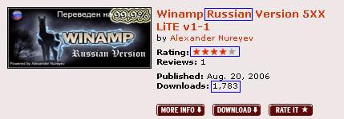
Possible solutions
Dedicated official websites
  User offer translation version
  Translation is offer in the form of plugin
  dedicated server to hold the plug-ins
  Relatively
Pic. 1 Plug-ins description from www.winamp.com

Slide 6
Continues
Dedicated localization websites
  Third party hold and offer the plug-in
  Often some software translation professional team participant
  Centralise the resource
  share translation memory
  Sometimes offer related tutorial

Slide 7
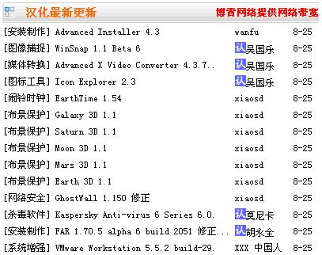
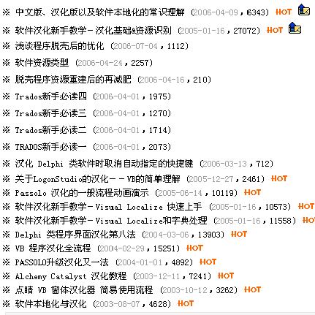
Continues

Slide 8
The standard three steps to localize
Identify localisable resource
  separate all the resource from code
  large pieces of resource can overflow
  list the resource to be localizable only when it is needed
Well designed API
  reduce the difficulty for localization
  XUL is one of option
  Mozilla project is one of the successful case

Slide 9
Continues
Easy access
  Offer some discussion forum or dedicated website
  contributor should be able to communicate with each other do discuss the issues

Slide 10
Case study

Slide 11
Future work
Industry standard

